Slide 1
Week 7 “buffer”
The syllabus has this a “buffer” week, to ‘focus’ on some topics that need a little more time. So, it’s:
Pointers (heap)
STL iterators (+containers/algoritm/predicates)
More (C++) file I/O (ifstream)

Slide 2
Recall:
C has no “strings”. Instead uses “char arrays”
So “strings” in C are literally arrays:
char myCString [] = “Michael”;
But:
arrays only “keep track of” or “point to” the START of the array ( location [0] )
an “array” variable is literally a pointer (to the start of the array), so
myArray[0] is THE SAME as *myArray
Like it’s LITERALLY the same thing: pointers and arrays ARE THE SAME THING in C/C++
SO: arrays DON’T keep track of the “size” (number of elements)
Pointers don’t, so arrays don’t either. Why? See above…
When “in scope”, sizeof() returns total number of bytes of the array
When “out of scope”, sizeof() returns the number of bytes of the pointer

Slide 3
Recall:
How does C “know” how many characters long a “string” is?
It doesn’t
Why? Because it’s literally a pointer, so the “size of the thing you are pointing to” doesn’t actually make any sense if you think about it…
Instead, it puts a “0” (zero) at the end of the array.
It ADDS a zero character. No ASCII/Unicode “0”, but actually 0.
This is also called “NULL”
#define NULL 0
…is somewhere in the libray
The “char” of this is the escape character + 0: ‘\0’

Slide 4
Recall:
This means that:
char myName[] = “Michael”;
Is REALLY: “Michael\0”
This is like a line of text has a “new line” at the end ‘\n’
But THIS isn’t a “string” (no zero at the end): char myName[] = { ‘M’, ‘i’, ‘c’, ‘h’, ‘a’, ‘e’, ‘l’ };
Isn’t this annoying?
You betcha it is…
So only use char strings if you have to. Otherwise use std::string
Problem is: you’ll have to…

Slide 5
Some “gotchas”
Your postal code won’t print out correctly…
Why?
Because there’s no zero (0) at the end.
Do you change it to a string?
No. Why? Because that’s the class/API
Remember: this is part of a larger application
So what should we do?

Slide 6
Some “gotchas”: “printing a string”
If you consider that the “char postalCode[7]” is an array…
Then it’s like asking why you can’t “print” these all at once:
int myNumberList[10];
cMonster myMonsters[10];
i.e. do these make sense (hint: no, they don’t):
cout << myNumberList << endl;
cout << myMonsters << endl;
In fact, it really doesn’t even make “sense” why you’d even want to do something like that – like something “built in”
The “problem” is that the “char array” LOOKS like a string…
…because it’s of type “char”

Slide 7
Some “gotchas”: “printing a string”
So how would you print out these?
int myNumberList[10];
cMonster myMonsters[10];
With a loop, right? One at a time, yeah?
Or with char, you could “push” the values into a stringstream, then extract the string from the stringstream, then print it… stringstream ssString; for (…int index…) { ssString << myCharArray[index]; } string myString = ssString.str(); cout << myString;

Slide 8
Some “gotchas”: “printing a string”
stringstream ssString; for (…int index…) { ssString << myCharArray[index]; } string myString = ssString.str(); cout << myString;
But HOLD ON! That’s just a loop, putting the characters into the stringstream one at a time!
Yes, yes it is.
So you could also print them out one at a time, too.
What ever makes more sense to you is fine.
But DON’T make it a string, because postalCode is an array.

Slide 9
Some “gotchas”: “printing a string”
Wait, why does this…
char myName[] = “Michael”;
Actually mean “Michael\0”?
Good question.
It’s because of the double quotes, which is a “string literal”
So “A” is really: “A\0” (because of the double quotes)
If you just want the single letter A, you would do ‘A’
With single quotes.
In other words: “A” != ‘A’ because…
“A” is a string literal ARRAY of 2 digits ‘A’ and ‘\0’ while ‘A’ is just one char.
…and NOT an array.

Slide 10
Pointers and extern
int x; // A variable. On the stack.
int x = 0; // A variable. On the stack. Assigned a value of 0;
extern int x; // A variable. On the stack. NOT in “this” file. // Is “external” to this file. // MUST be declared somewhere (in some file) // or the LINKER will complain (can’t find it)
“NEVER” use variables without extern in a header file.
Assigning the value bypasses the extern:
extern int x = 0; same as : int x = 0;

Slide 11
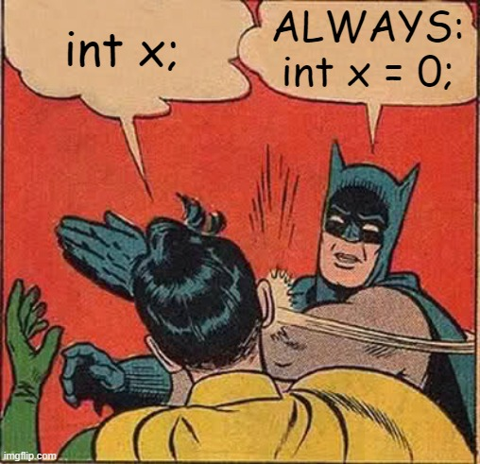
RAII (Resource Acquisition Is Initialization)
Claimed to be a “C++ thing”, but that’s not really true
Idea is that this might be dangerous:
int x;
Why? Because we don’t know what the value of x is.
Why doesn’t C/C++ assign a value?
Because “x” might be anything: output, the screen, who knows?
It’s not always just a variable you are using.
But it is a Good Idea for the most part.
But it’s not a YOU MUST ALWAYS DO THIS sort of rule…
…understand why the rule is there.

Slide 12
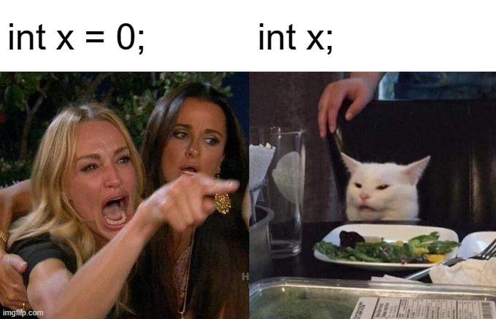
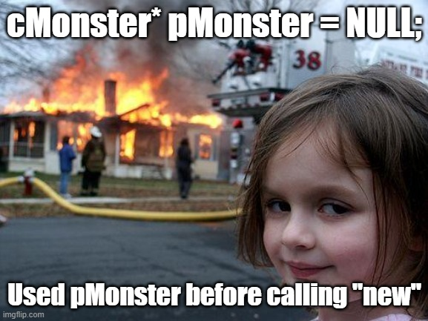
RAII (Resource Acquisition Is Initialization)
Sometimes (many times, actually), you:
Don’t know the value of something
It will change
You need to initialize it later
This is especially true of pointers, or values that don’t have a clear “default” value.
But why the RAII “rule”?
To prevent you accidentally using it with a bad value, right?
So it’s mostly right, but not “hard and fast”

Slide 13
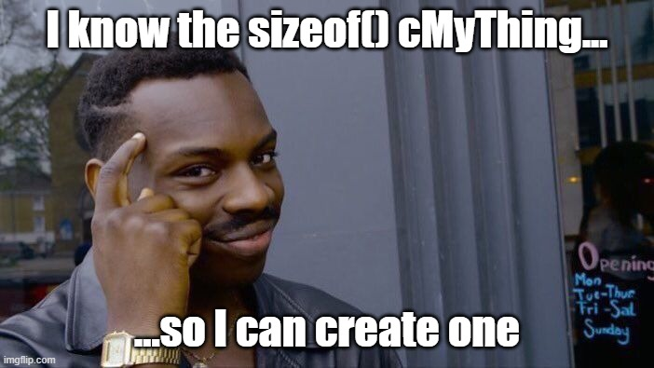
RAII (Resource Acquisition Is Initialization)
Here’s a very simple example, a plain old array.
int myArray[100]; // At compile time, it’s 100 items. Side note: what are the values…? Hmmmm…
Set at compile time.
Compiler needs to “know” the size so it can place variables (in memory) before or after, OR if it’s inside a class: class cMyThing { int myArray[100]; };

Slide 14

RAII (Resource Acquisition Is Initialization)
class cMyThing { int arraySize; int myArray[x]; };
How big is this?
Who knows?
So what’s the compiler supposed to do with this?:
cMyThing myArrayOfThings[100];
Remember: this is fixed AT COMPILE TIME, but cMyThing has an array that ISN’T even known at compile time (i.e. it can change), right?

Slide 15
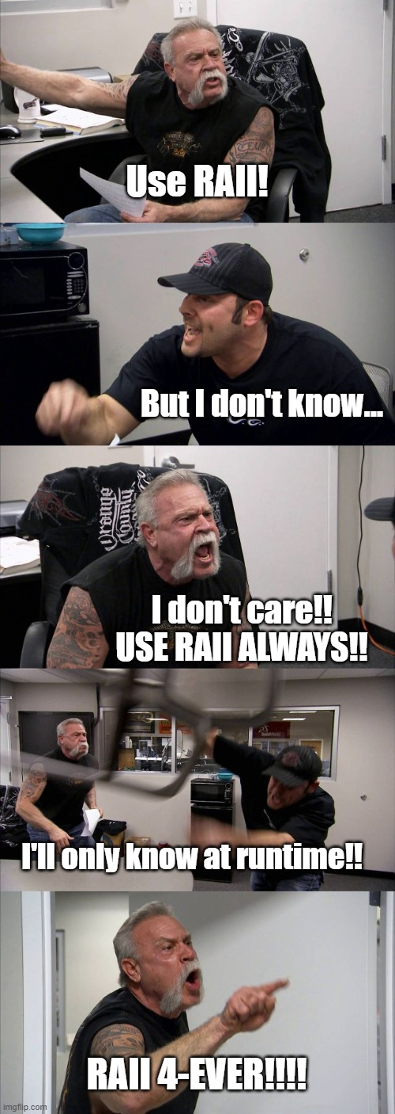
RAII (Resource Acquisition Is Initialization)
So C/C++ sucks, then.
I mean, I can do that in Java/Python/whatever…
And it’s a “rule”, right?
So you ALWAYS do that, right?
It’s The Best Way, right?
Maybe, unless it’s not.
Remember: the rules/guidelines are there for a reason.
Like the “file name = class” in Java. Why?

Slide 16
Back to pointers…
In C, there was no “by reference”
“pass by reference” was done with “pass by pointer”
C++ added the idea of “reference” and co-opted the “&” symbol.
In “C”, it means “address off” (the memory address of)
In “C++”, it could also mean “by reference”
But the other thing is with pointers, it doesn’t always “make sense” to do RAII…
… even for simple thing, like arrays…

Slide 17
Back to pointers…
int myArray[100]; // On stack. Set a compile time. Can’t change. // Classic RAII
If you want to create an array at run time, you do this:
int* pMyArray = new int[100]; // Creates and array of 100 things …or int x; cin >> x; int* pMyArray = new [x]; // Creates an array of x things (Again, side note: what are the values inside that array? Who knows?!)

Slide 18
Back to pointers…
int x; cin >> x; int* pMyArray = new [x]; // Creates an array of x things pMyArray is a “pointer to an int”
Remember, arrays and pointers are literally the same thing.
So this makes sense: pMyArray is pointing to the start of the array.

Slide 19
Back to pointers…
int x; cin >> x; int* pMyArray = new [x]; // Creates an array of x things
For each “new”, you need a “delete”, but with arrays, you add the []
To delete this array, you would write: delete [] pMyArray;
int* pX = new int; // Creates one int
delete pX; // Deletes that ONE int
Technically, it “marks the memory as available”: it doesn’t “delete” anything. But if you access that location after the delete, it’ll be bad.

Slide 20
Back to pointers…
int* pX = new int(); // Creates one int
int* pX = new int[1]; // Also creates one int (but an array)
Top one: delete pX;
Bottom one: delete [] pX;
Note that the run time DOES know how large the array is…
…otherwise “delete []” wouldn’t know how much memory to delete…

Slide 21
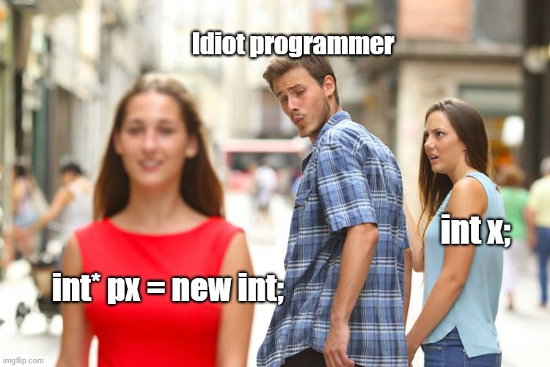
Back to pointers…
Now, this sort of thing is just plain stupid:
int* pX = new int; // Creates one int
int* pX = new int[1]; // array of 1 int
You wouldn’t create 1 primitive (built in) variable. That’s just stupid and confusing.
But you might create one cMonster.
…or an array of ints.
…or something else.

Slide 22
Back to pointers…
Why do this?
cMonster *pMonster = new cMonster();
When you could do this?
cMonster myMonster;
Likely it’s because you:
Don’t know when the monster should be created.
You don’t know what the default values should be.
You aren’t controlling when the monsters are created (like you are using the monster, but something else is actually creating them: “factory” class/method).
Many thing are accessing the one monster.

Slide 23
Back to pointers…
Why do this?
cMonster *pMonster = new cMonster();
When you could do this?
cMonster myMonster;
If you use the 2nd way, then you could:
Pass around references to everything that needs it
Change the default values once you know
AND be careful NOT to use it until you need it
Pass around pointers that have the address of the stack variable.

Slide 24
Back to pointers…
So, if you are:
Using references anyway…
Have to overwrite the default…
…and be careful about NOT using the default values (i.e. you can’t actually use this monster until it’s “valid”)
…and you might be passing pointers around anyway…
Why not just use a pointer value in the 1st place?

Slide 25
“Managed” and “unmanged”
“Managed” means that the language (the runtime) keeps track of who’s using what and when.
This DOESN’T keep track of IF the value is NOT “supposed” to be used, just that something is using it.
(Keep that in mind)
Every so often, the “garbage collector” runs and “cleans up” unused variables.
Note that this can slow things down AND…
…there’s an overhead cost to it.
But it “pretends” that all variables “sort of” behave like “stack” variables.

Slide 26
“Managed” and “unmanged”
“unmanaged” means that there is no garbage collector.
YOU are 100% responsible for memory management.
If you created it, you:
Keep track of who’s accessing it
When (and what) destroys it
If you don’t, the program will crash.
…or you’ll get a memory leak.

Slide 27
“Managed” and “unmanged”
Stack variables:
Use the “.” (dot) operator
Heap variables (i.e. they are on the heap)
Use the “->” (arrow or indirection) operator
Note that “->” is also used for pointers to anything, clarifying that it’s a pointer and not a regular stack variable.
So even if the variable isn’t technically on the heap, we’ll refer to them as “heap” variables (i.e. you are “getting at them” using a pointer)

